Slide 1

ABE 715
Computer Programming
Lecture 5: Data Structures
Lists, Tuples, and Dictionaries
Dr. Kadeghe G. Fue
Department of Agricultural Engineering
1

Slide 2
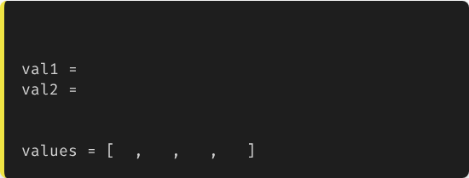

Recap: Loops
In Lecture 4, we learned how to repeat actions using for and while loops.
# We need a container
# Instead of this:
Usually, we loop through data.
23
24
The Question: How do we store that data efficiently? We cannot create a variable for every single sensor reading (temp1, temp2, ... temp1000).
# We want this:
23
24
22
25
2

Slide 3

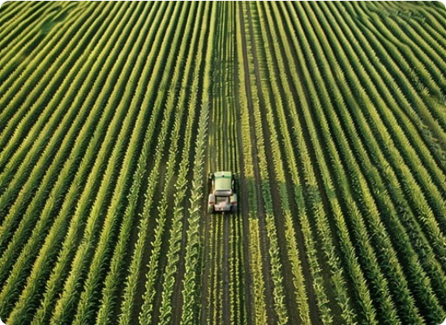
The List
Ordered Sequences
A List is a mutable, ordered sequence of elements.
•
Ordered: The order matters (Time series data).
•
Mutable: You can change, add, or remove items.
•
Mixed Types: Can hold ints, floats, and strings together.
3

Slide 4
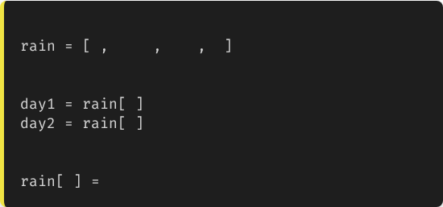
Creating Lists
# A list of daily rainfall (mm)
0
12.5
5.0
0
Lists are defined by square brackets [].
# Accessing data
0
# Returns 0
You can access items using their Index (starting at 0).
1
# Returns 12.5
# Changing data
3
2.0
# Update last value
4

Slide 5
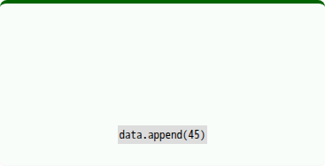
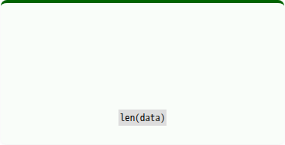
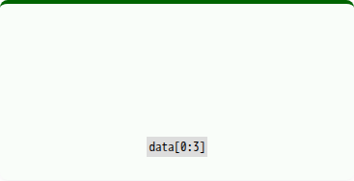
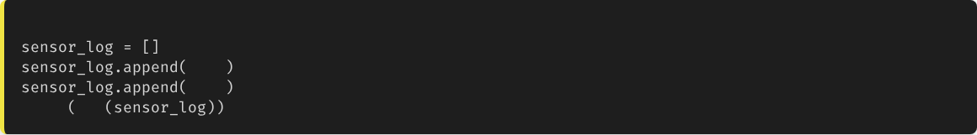
List Operations
.append()
len()
Slicing
Adds an item to the end.
Returns the number of items.
Get a subset of data.
# Engineering Use: Real-time logging
23.5
24.1
print
len
# Output: 2
5

Slide 6
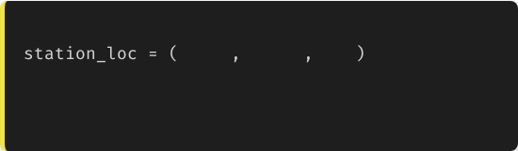
Tuples: Immutable Lists
Fixed Data
Defined by parentheses ().
# Lat, Lon, Elevation
-6.82
37.65
500
Immutable: Once created, they cannot be changed. This is safer for data that should not change.
# This causes an error:
# station_loc[0] = -7.0
Use Case: GPS Coordinates of a static weather station.
6

Slide 7
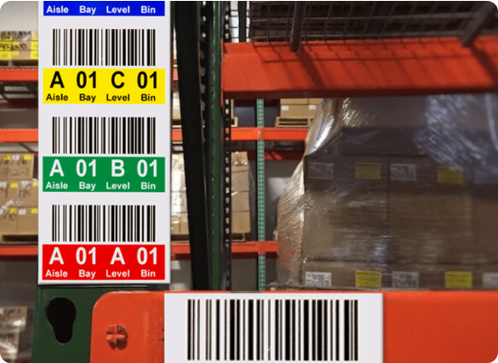
Dictionaries (Key-Value Pairs)
Mapping Data
Lists access data by position (Index 0, 1).
Dictionaries access data by Name (Key).
Defined by curly braces {}.
Analogy: Labeled bins in a warehouse. You look up the "Label" (Key) to get the "Item" (Value).
7

Slide 8
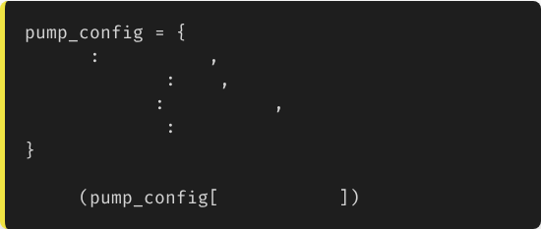
Structuring Object Data
"id"
"PUMP_01"
In Ag Engineering, we often describe a "thing" (like a pump or a field).
"flow_rate"
500
"location"
"Block_A"
"is_active"
True
A dictionary is perfect for this.
print
"flow_rate"
8

Slide 9
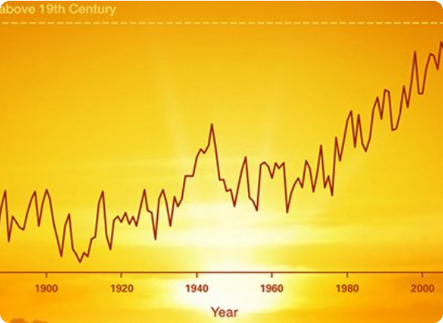
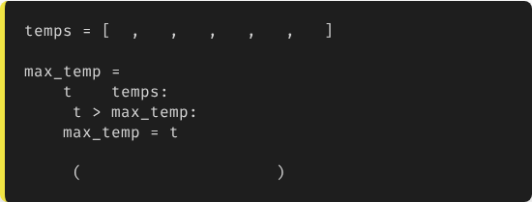
Case 1: Time Series (Lists)
Analyzing Trends
We use Lists for continuous data.
Task: Find the maximum temperature in a day.
22
24
28
31
29
25
0
for
in
if
print
f"Peak: {max_temp}C"
9

Slide 10
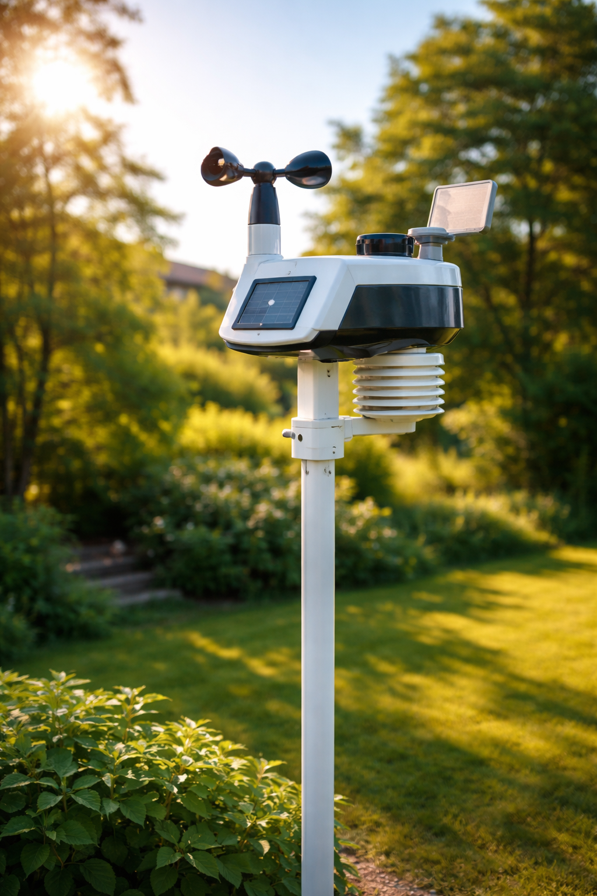
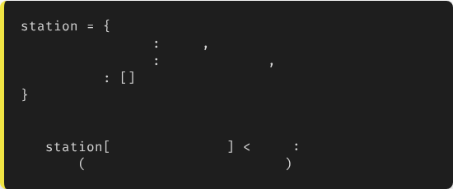
Case 2: Sensor Metadata (Dicts)
Describing a System
We use Dictionaries to keep related attributes together.
"batt_voltage"
12.4
"last_service"
"2023-10-01"
"errors"
# Check battery health
if
"batt_voltage"
11.0
print
"Alert: Replace Battery"
10

Slide 11
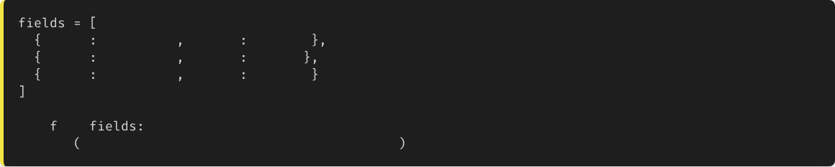
List of Dictionaries
In real IoT systems, we often have a List of devices, where each device is a Dictionary.
"name"
"Field_A"
"crop"
"Maize"
"name"
"Field_B"
"crop"
"Rice"
"name"
"Field_C"
"crop"
"Beans"
for
in
print
f"Monitoring {f['crop']} in {f['name']}"
11

Slide 12





Best Practices
Choose Wisely
Naming
Safety
Use Lists for data that is ordered or sequential (Time).
Lists should be plural (sensors, values).
Use Tuples for constants like physical locations or calibration coefficients.
Use Dicts for data that is descriptive (Properties).
Dicts should be singular (sensor_config, profile).
12

Slide 13

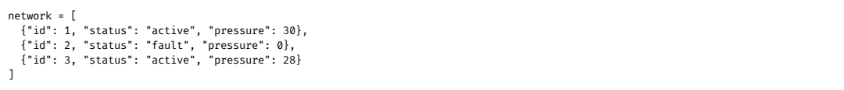
Lecture 5: Take-Home Assignment
Sensor Network Analysis
Scenario: You have a list of sensor dictionaries representing a drip irrigation system.
Task: Write a script that iterates through the network and prints the ID of any sensor where status is "fault".
13

Slide 14
Questions?
Next Class: Functions and Modular Code
Dr. Kadeghe G. Fue
Department of Agricultural Engineering
14

